Slide 1
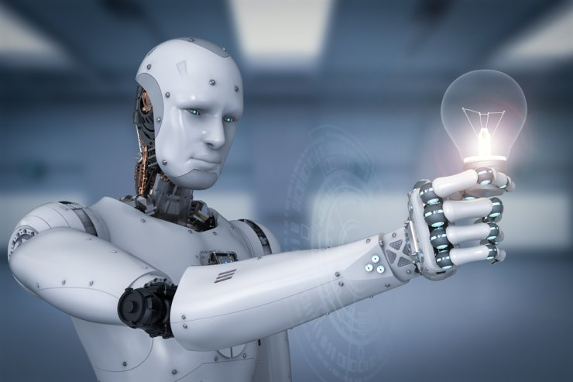
ETHICAL DILEMMA OF SOCIAL ROBOTS
Rafay Aamir rafay.aamir.gull@gmail.com
Muhammad Aetisam

Slide 2


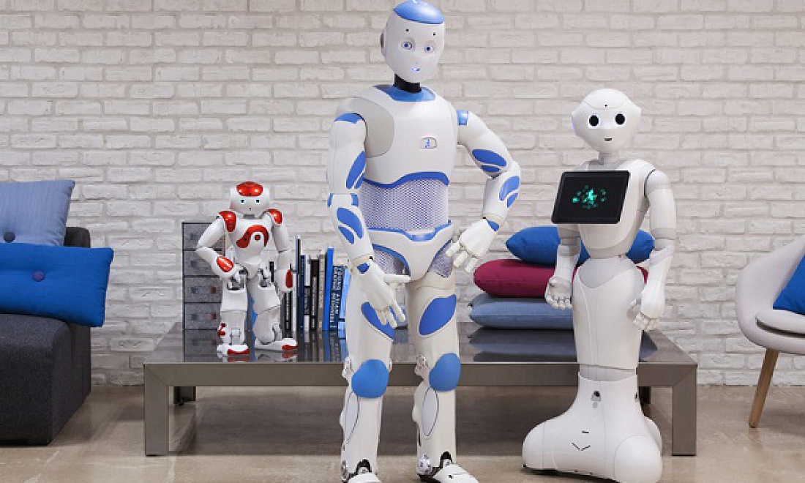



Real-world Social Bots vs Sci Fi social Bots

Slide 3
What is Life?
Aristotle's view was that a living organism has both “matter” and “form”.
This differs from the philosophical position known as materialism.
Materialism does not entertain any notion of organisms having a “form” or “soul”; rather, organisms are made simply of various types of “matter.”
The philosophical position society adopts will inevitably have a huge impact on how humans interact with robots.

Slide 4
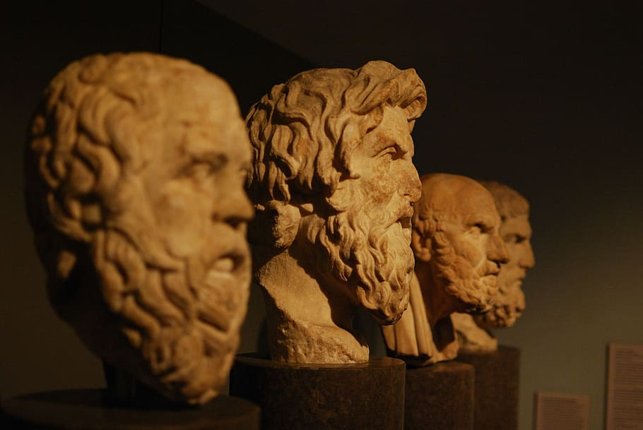
Materialism
If Think under materialism, can robots and humans be equal?
Does a robot have to give its life for a human?
Does a human have to give his life for a robot?
Would the living robots be superior to their makers (Humans)?
Most materialistic minds like Aristotle (Greek philosopher), believe that one day, robots will become a life forms like plants, animals, and humans.

Slide 5
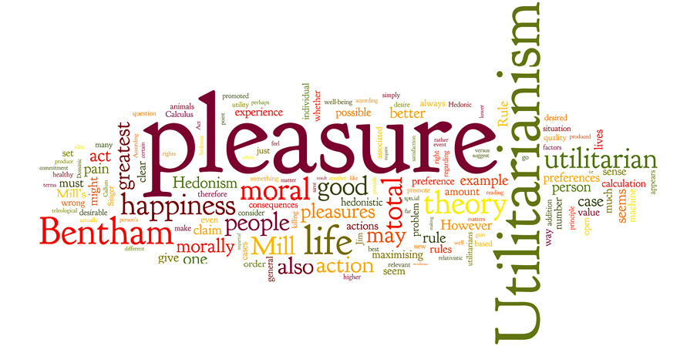
Utilitarianism
Utilitarianism is a moral philosophy that stresses the repercussions of one’s actions. It tries to minimize the suffering and maximize the happiness of one’s i.e., cost beneficial action.
Assembly line job Replaced by Robots.
Advantages:
Save money, increase business profit, decrease price of manufactured products
Disadvantages:
They threaten to eliminate jobs, isolate the elderly from human interaction, endanger our lives, maybe driving us extinct.

Slide 6
What is Robot?
The term robot has no fixed and predefined meaning.
Robot is derived from Slavonic language ‘ROBOTA’ means “Forced Labor”.
“Robot” was first introduced in Karel Capek Play in 1920.
Greek God Hephaestus made of robot Gold
Mechanical Human
Knights Robots construction in Leonardo Da Vinci’s journal which was published in Timeline of Robotics

Slide 7
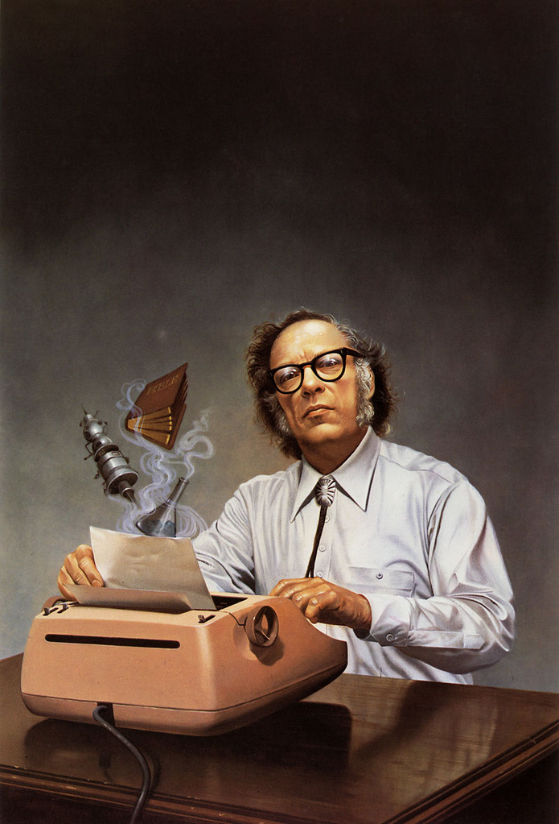
Law of Robotics
Isaac Asimov, the inventor of the term robotics has put forward the popular Three Laws of Robotics published in a short story ‘Runaround’ in 1942.
A Robot may not harm a human.
A Robot must follow instructions of a human unless an unlit the first law violates.
A Robot must protect itself while not violates the 1st and 2nd law.

Slide 8
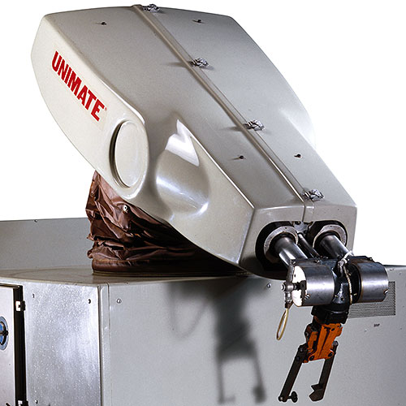
First industrial Robot
The Unimate
By Joseph Engelberger, the father of Robotics
Used by American car company General Motors (GMC) in 1961.

Slide 9
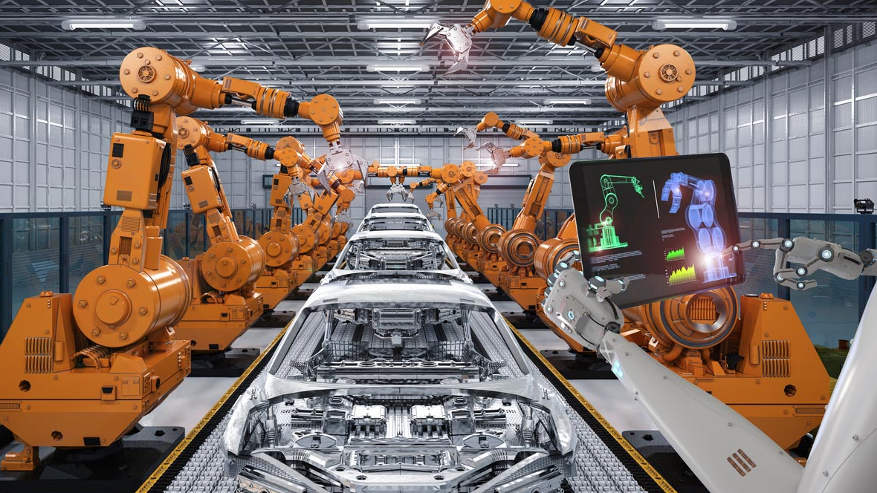
Number of Robots in industry
What do you think how many industrial robots are installed every year?
Five hundred thousand (500,000)
A recent study by the McKinsey Global Institute (2013) predicts that the market value for advanced robotics will be up to $17 trillion US per year by 2025.

Slide 10
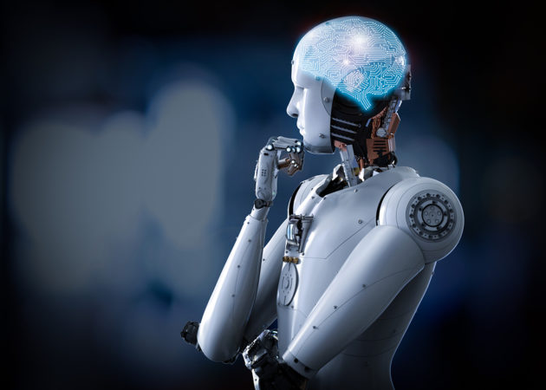
Is it ethical to utilize robots and AI in the long run?
Or do the disadvantages outweigh the benefits?
Can we choose to support particular applications of robots and AI while restricting others?

Slide 11
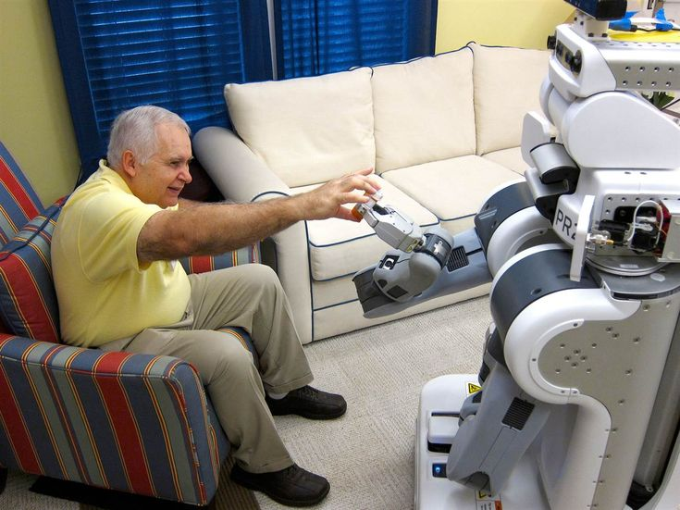

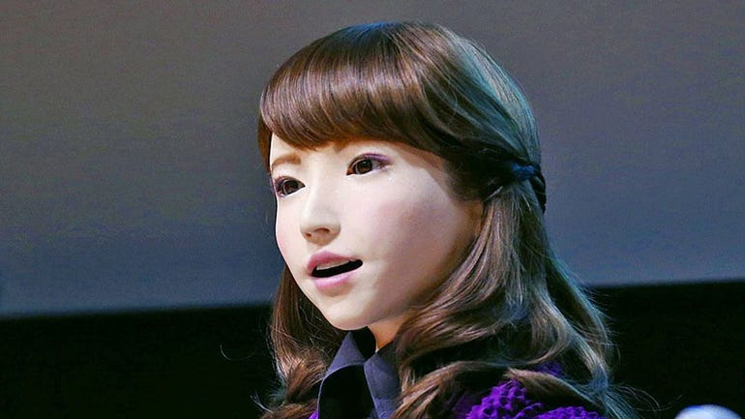
Why Social?
Emotionally and social robots are already being used in health care and will be ubiquitous very soon.
Siri, Alexa, Google Assistant and Cortana.
Old care.
Child education.
Companionship.
Maid.
Rob Receptionist.
Robot news Anchor (Erica).

Slide 12
Dilemmas and Problems
a situation in which a difficult choice has to be made between two or more alternatives, especially ones that are equally undesirable.
a matter or situation regarded as unwelcome or harmful and needing to be dealt with and overcome.

Slide 13
Issues?
Trolley Problem.
Companionship.
40% of the world wants a relationship with robot.
Social robots affect our family life in anyway?
Positive and Negative impact on our Children, Elders, industrial sector, national Security.

Slide 14
Solution?
Collect data from people how we can improve Ethical issues in social Robots.
Designer of the Social robot must consider the reported ethical dilemma and issues of the social robots.
Designer do not consider the specific application of social Robots he has to see the big picture of how they can impact the society.
AI engineer also consider the above scenario when he was in phase of training of the model.
The network Security must be full proofed that it will never get hacked.

Slide 15
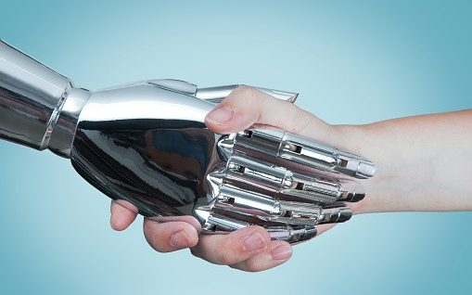
Justice Approach in Robots
How can we utilize robots and artificial intelligence to promote justice and fairness?
Robotics and artificial intelligence (AI) may be able to provide additional assistance to those who require it.
Robotics and AI may violate justice and equity. The right to equality, the prohibition of discrimination, and the right to privacy may all be jeopardized using big data and AI.

